Slide 1


Denis O'Byrne
2/20/2022

Slide 2
Outline
Executive Summary
Introduction
Methodology
Results
Conclusion
Appendix

Slide 3

Executive Summary
Summary of methodologies:
Data Collection using Webscraping and REST API queries
Data Wrangling to Classify Lauches based on Success and transform data into standardized numeric form
Exploratory Data Analysis using SQL and Visualization packages for Python
Interactive Plotly Web App to visualize payload and success launch data at each Launch Site
Exploring Launch Sites using interactive Folium Maps
Predictive analysis for classification of Rocket Landing Success
Summary of all results:
Exploratory Data Analysis Results
Predictive Analysis Results

Slide 4
Introduction
SpaceX advertises Falcon 9 rocket launches on its website, with a cost of 62 million dollars; other providers cost upward of 165 million dollars each, much of the savings is because SpaceX can reuse the first stage. Therefore if we can determine if the first stage will land, we can determine the cost of a launch. This information can be used if an alternate company wants to bid against SpaceX for a rocket launch. Thus it is advantageous to be able to predict whether the Falcon 9 first stage will land successfully for new missions.
To make valuable predictions we must solve the following:
What factors of a mission influence Falcon 9 launch success?
What conditions must be met by SpaceX to ensure the highest probability of success for a given mission?

Slide 5

Section 1

Slide 6

Methodology
Data collection methodology:
Requested past launch data from SpaceX's Rest API https://api.spacexdata.com/v4
Webscraped tabular data on SpaceX launches from
Perform data wrangling
Dropped data on non Falcon 9 launches
Used One Hot Encoding to transform categorical variables into factors
Transformed factors to integers
Replaced missing numerical data for payload masses with the sample mean
Classified data as 1 for Successful Landing or 0 for failed landing
Performed exploratory data analysis (EDA) using visualization and SQL:
Used Scatter Plots and Bar Graphs to visualize relationships between variables
Used SQL Queries to understand the data collected

Slide 7
Methodology Continued
Perform interactive visual analytics using Folium and Plotly Dash
Interactive Plotly Web App to visualize payload and success launch data at each Launch Site
Exploring Launch Sites using interactive Folium Maps
Perform predictive analysis using classification models:
Built and tuned multiple classification models to predict landing success
Used Grid Search and Cross Validation to find the best model parameters for each model tested (Logistic, SVM, Decision Tree, and KNN)
Split Data into testing and training to test model accuracy resilience on Out of Sample Data
Selected top performing Model on both testing and training set based on accuracy of predictions

Slide 8
Data Collection
Used SpaceX REST API to gather data on rocket launches:
https://api.spacexdata.com/v4
API provides data on rockets used, launch dates, payload masses, launch success or failure, launch site name and location (latitude and longitude), booster version (note for this experiment we are only interested in Falcon V9 boosters), landing outcome, etc. (47 columns of data for each launch in total)
Our Goal is to Predict the Landing outcome using the other variables
Falcon 9 launch data was also collected via Webscraping Wikipedia using BeautifulSoup from the page below:
https://en.wikipedia.org/w/index.php?title=List_of_Falcon_9_and_Falcon_Heavy_launches&oldid=1027686922

Slide 9

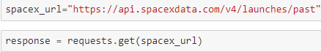
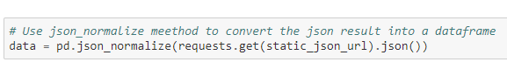
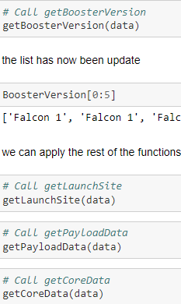
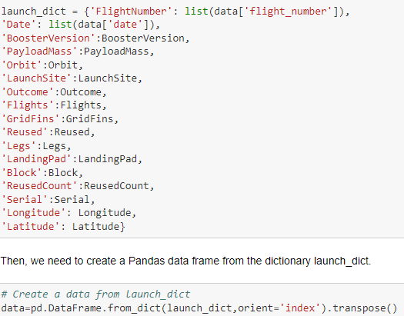
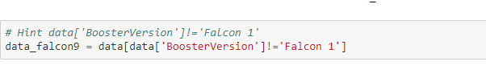
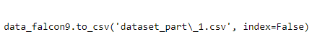
Data Collection Steps – SpaceX API
Github URL to Notebook :
Space X API Data Collection Notebook by Denis O'Byrne
Get Response from API
Convert Response to JSON File then read as Pandas data frame
Clean data to extract desired information using custom functions
Assign cleaned data to a new data frame using dictionary of lists
Filter data for Falcon V9 boosters only then export to csv
Note for this project a static version of the data is used from the following url:
https://cf-courses-data.s3.us.cloud-object-storage.appdomain.cloud/IBM-DS0321EN-SkillsNetwork/datasets/API_call_spacex_api.json

Slide 10
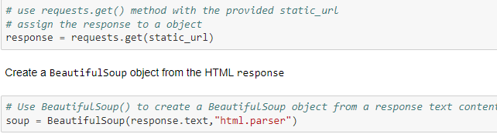
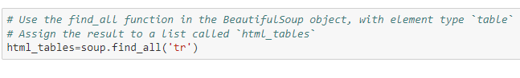
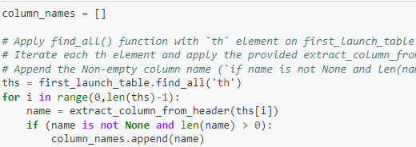
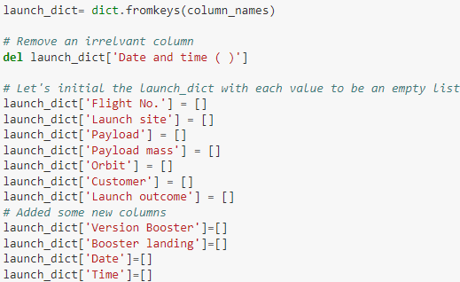
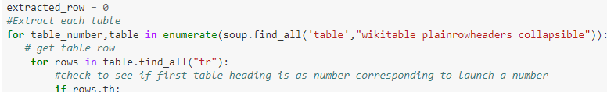
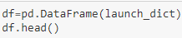
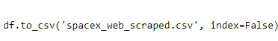
Data Collection Steps – Webscraping Wikipedia
Github URL to Notebook : Webscraping Notebook by Denis O'Byrne
Get Response from HTML and create Soup object
Find Tables
Extract column names
Create Launch Data Dictionary
Extract table data to dictionary
Create data frame from dictionary
Export to CSV
Note for this project a static version of the data is used from the following url:
https://en.wikipedia.org/w/index.php?title=List_of_Falcon_9_and_Falcon_Heavy_launches&oldid=1027686922

Slide 11
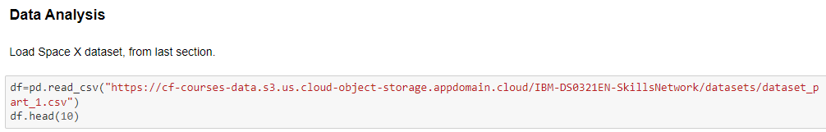
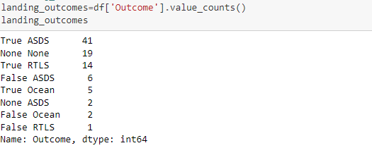
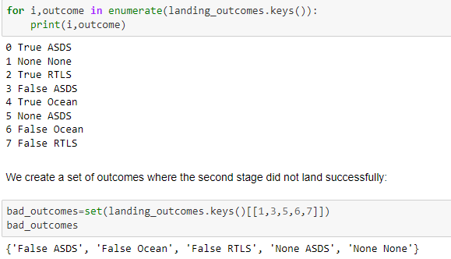
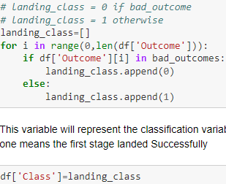
Data Wrangling – Training Labels
Plan:
In the data set, there are several different cases where the booster did not land successfully. Sometimes a landing was attempted but failed due to an accident; for example, True Ocean means the mission outcome was successfully landed to a specific region of the ocean while False Ocean means the mission outcome was unsuccessfully landed to a specific region of the ocean. True RTLS means the mission outcome was successfully landed to a ground pad False RTLS means the mission outcome was unsuccessfully landed to a ground pad. True ASDS means the mission outcome was successfully landed on a drone ship False ASDS means the mission outcome was unsuccessfully landed on a drone ship.
To convert those outcomes into Training Labels with 1 means the booster successfully landed 0 means it was unsuccessful
Steps:
Load data
Identify Landing outcomes as good and bad
Create a list of training labels
Add list to data frame in new column "Class"
Github URL to Notebook : Data Wrangling Notebook by Denis O'Byrne

Slide 12
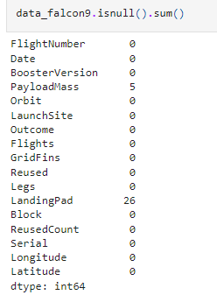
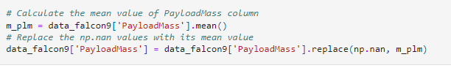
Data Wrangling – Imputing Missing Data
In the earlier SpaceX API notebook we performed data wrangling to impute missing data
Steps:
Check for Missing Values
Note we found 5 missing values for Payload Mass which should not be missing and nonzero. We will replace theses missing values with the Sample Mean
Note we found 26 entries of None for Landing Pad which is informative indicating there was no landing pad to land the rocket on for the mission meaning we should not change this column
Calculate Sample Mean For Payload mass
Replace nas for Payload mass with sample mean
Github URL to Notebook : Space X API Data Collection Notebook by Denis O'Byrne

Slide 13

EDA with Data Visualization
Visualize Orbits of Rockets and Count Launches in each orbit
Larger orbits require more fuel which may impact launch landing success
Bar Graph to show landing success percentage for given Orbit Launches
By grouping our success based on orbit we can see if our intuition and combining this chart with our orbits visualization we can see the relationship between orbit radius and landing success
Scatter Plots to show the relationships between the following Variables and visualize their correlation:
Flight Number vs. Payload Mass
Flight Number vs. Launch Site
Payload Mass vs Launch Site
Orbit vs Flight Number
Payload Mass vs. Orbit
Line Graph to show landing success percentage with respect to the year of launch
We expect SpaceX Engineers to learn from their mistakes and improve over time but how fast are they improving
Github URL to Notebook :
EDA Data Visualization in Python by Denis O'Byrne

Slide 14

EDA with SQL
Used SQL Queries to an IBM DB2 instance to gain insight on the dataset
Desired Insight:
Display the names of the unique launch sites in the space mission
Display 5 records where launch sites begin with the string 'CCA'
Display the total payload mass carried by boosters launched by NASA (CRS)
Display average payload mass carried by booster version F9 v1.1
List the date when the first successful landing outcome in ground pad was achieved
List the names of the boosters which have success in drone ship and have payload mass greater than 4000 but less than 6000
List the total number of successful and failure mission outcomes
List the names of the booster versions which have carried the maximum payload mass
List the failed landing_outcomes in drone ship, their booster versions, and launch site names for in year 2015
Rank the count of landing outcomes (such as Failure (drone ship) or Success (ground pad)) between the date 2010-06-04 and 2017-03-20, in descending order
Github URL to Notebook:
SQL Query Notebook By Denis O'Byrne

Slide 15

Built an Interactive Map with Folium
Visualized Launch Data in an interactive Map
Used Latitude and Longitude Coordinates of Launch Sites to Add Circle Markers with the site names labeled
Assigned Launch Outcome (Success/Failure) from the data frame to Classes 1 and 0 respectively and assigned the classes Green and Red markers on the map to Marker Clusters grouped by Launch Site
Used lines and points to measure (via Haversine's Distance Formula) and label the minimum distances of the launch sites to:
Cities
Highways
Coastlines
Railways
Answered the following Questions:
Are launch sites in close proximity to railways? Yes
Are launch sites in close proximity to highways? Yes
Are launch sites in close proximity to coastline? Yes
Do launch sites keep certain distance away from cities? About 50 km
Github URL to Notebook :
Folium Map Notebook by Denis O'Byrne

Slide 16
Build a Dashboard with Plotly Dash
Built Plotly Dashboard to make an interactive web app to visualize launch data
Includes Pie Charts to visualize launch landing success broken down by Launch Site
If all sites are selected we get the proportion successful launch landings each site accounts for
If we select an individual site we see the proportion of all launches at that site which landed successfully
Includes Scatter Plot of Payload Mass (kg) vs Landing Success Rating (0 for Failure, 1 for Success) color coded by booster version
Selecting a single site removes points from other sites, Selecting All includes all data
Plot Payload Mass Range can be selected by a slider for Min and Max values
Github URL to Notebook that Runs the App :
Plotly Dashboard App for SpaceX launches by Denis O'Byrne Final

Slide 17

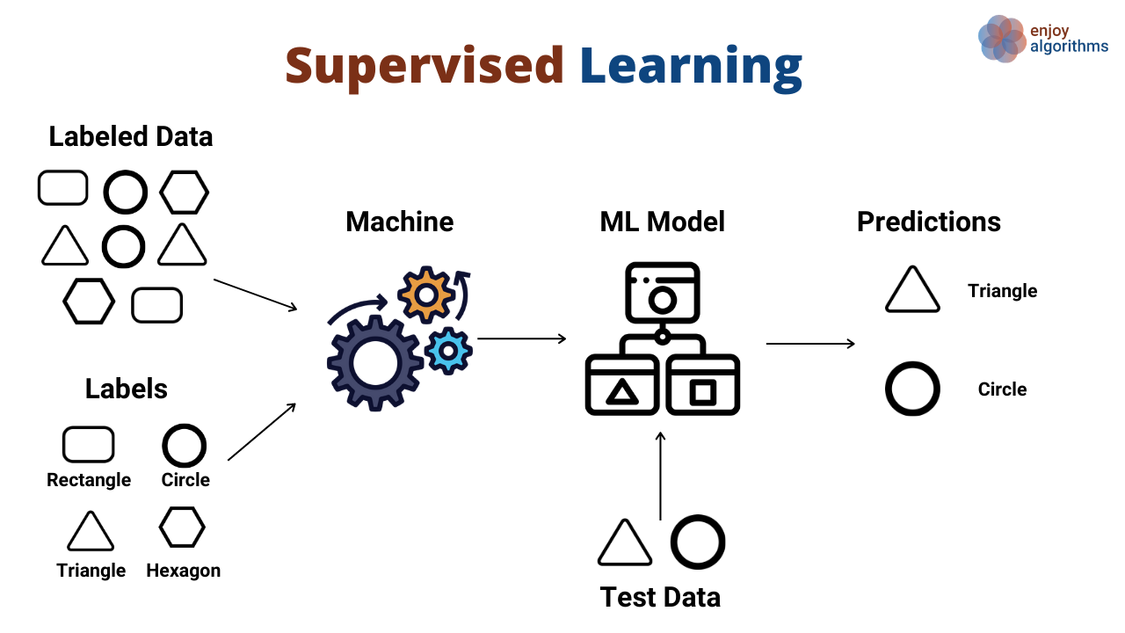
Predictive Analysis (Classification)
Build
Building Model:
Transform data to Scale the columns
Split Data into Testing and Training Sets
Selected machine learning algorithms to use for classification (KNN, Decision Tree, SVM, Logistic Regression)
Use Grid Search and Cross Validation to find best tuning parameters for each model fitting on training sets
Evaluate
Evaluating Model:
Check accuracy of each model on training and testing sets
Plot Confusion Matrix
Improve
Improving Model:
Feature Engineering
Algorithm tuning
Select
Selecting the best performing classifier:
Model with the best accuracy score on test set is the best model. If there is a tie, check accuracy on training set as well
Github URL to Notebook :
Machine Learning Prediction Model Notebook by Denis O'Byrne

Slide 18

Results
Exploratory data analysis results
Interactive analytics demo in screenshots
Predictive analysis results

Slide 19

Section 2

Slide 20

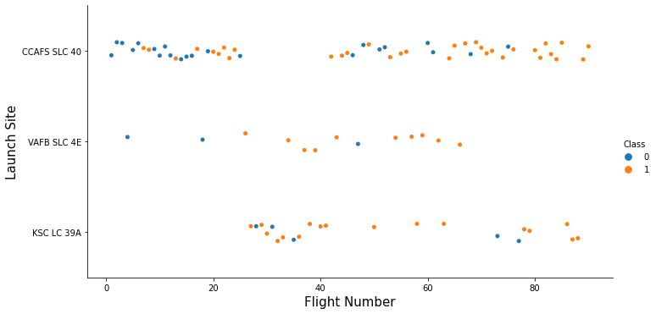
Flight Number vs. Launch Site
We can see that as the flight number increases the number of successful landings increases
We also see that as more flights occur at a given launch site, the number of successful landings increases

Slide 21
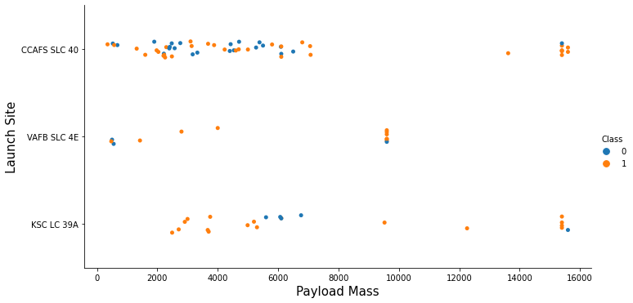
Payload vs. Launch Site
We can see that as payload mass increases for Site CCAFS SLC 40, the probability of a successful landing increases
There is not a clear correlation between payload mass and launch success for the other two sites
Lastly we find that middle mass launches (~9,000kgs) are usually performed at VAFB SLC 4E but the other two sites launch heavy masses (>10,000kgs) while VAFB SLC 4E does not

Slide 22

LEO: Low Earth orbit (LEO)is an Earth-centred orbit with an altitude of 2,000 km (1,200 mi) or less (approximately one-third of the radius of Earth),[1] or with at least 11.25 periods per day (an orbital period of 128 minutes or less) and an eccentricity less than 0.25.[2] Most of the manmade objects in outer space are in LEO \[1].
VLEO: Very Low Earth Orbits (VLEO) can be defined as the orbits with a mean altitude below 450 km. Operating in these orbits can provide a number of benefits to Earth observation spacecraft as the spacecraft operates closer to the observation\[2].
GTO A geosynchronous orbit is a high Earth orbit that allows satellites to match Earth's rotation. Located at 22,236 miles (35,786 kilometers) above Earth's equator, this position is a valuable spot for monitoring weather, communications and surveillance. Because the satellite orbits at the same speed that the Earth is turning, the satellite seems to stay in place over a single longitude, though it may drift north to south,” NASA wrote on its Earth Observatory website \[3] .
SSO (or SO): It is a Sun-synchronous orbit also called a heliosynchronous orbit is a nearly polar orbit around a planet, in which the satellite passes over any given point of the planet's surface at the same local mean solar time [4] . (800 – 1000 km)
ES-L1 :At the Lagrange points the gravitational forces of the two large bodies cancel out in such a way that a small object placed in orbit there is in equilibrium relative to the center of mass of the large bodies. L1 is one such point between the sun and the earth \[5] .
HEO A highly elliptical orbit, is an elliptic orbit with high eccentricity, usually referring to one around Earth \[6].
ISS A modular space station (habitable artificial satellite) in low Earth orbit. It is a multinational collaborative project between five participating space agencies: NASA (United States), Roscosmos (Russia), JAXA (Japan), ESA (Europe), and CSA (Canada) \[7]
MEO Geocentric orbits ranging in altitude from 2,000 km (1,200 mi) to just below geosynchronous orbit at 35,786 kilometers (22,236 mi). Also known as an intermediate circular orbit. These are "most commonly at 20,200 kilometers (12,600 mi), or 20,650 kilometers (12,830 mi), with an orbital period of 12 hours \[8]
HEO Geocentric orbits above the altitude of geosynchronous orbit (35,786 km or 22,236 mi) \[9]
GEO It is a circular geosynchronous orbit 35,786 kilometres (22,236 miles) above Earth's equator and following the direction of Earth's rotation \[10]
PO It is one type of satellites in which a satellite passes above or nearly above both poles of the body being orbited (usually a planet such as the Earth
Orbit Types and Radius Visualization

Slide 23

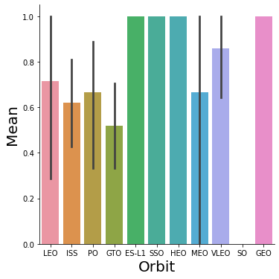
Success Rate vs. Orbit Type
ES-L1, SSO, HEO, and GEO orbits have perfect landing scores
From the previous slide we find that orbits within 450-10000 kilometers have the highest rate of success
Launches beyond 10000 km have lower success ratings
Launches between 1000-2000 km have less success than launches between 1000-450 km (lower altitude) and launches between 2000-10000km (higher altitude)

Slide 24
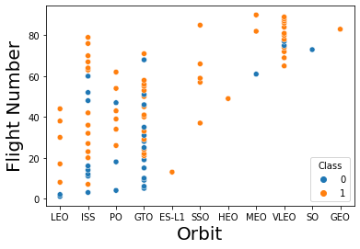
Flight Number vs. Orbit Type
For LEO and PO orbits the Success appears related to the number of flights
There seems to be no relationship between flight number and success when in GTO or ISS orbit

Slide 25
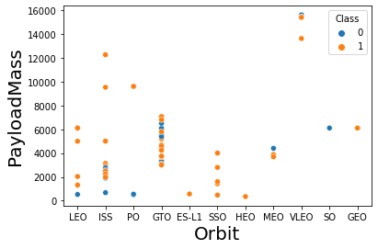
Payload vs. Orbit Type
PO, LEO and ISS Orbits have higher probability for successful landings as payload mass increases
GTO orbits have no correlation between payload mass and landing success
All other orbits do not have enough data to indicate a relationship between payload mass and orbit type

Slide 26
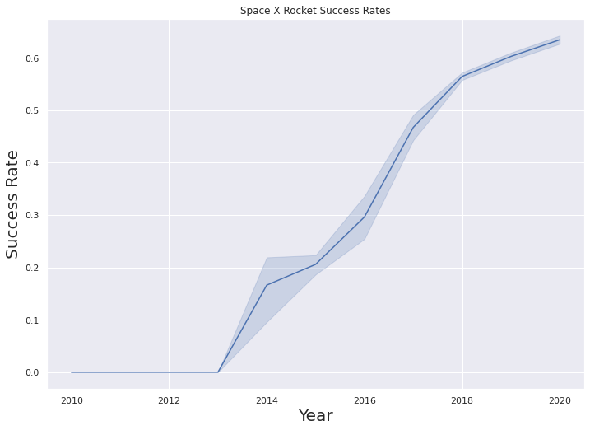
Launch Success Yearly Trend
We can see that there were no successful landings prior to 2013
We also see that since 2013 the probability of successful landings has increased every year however in recent years (2018-2020) the yearly rate of increase has declined with a maximum probability of success being about 0.65 in 2020

